Slide 1

HI-TEC
Electronic Supply Ltd
M³CS INTEGRATED WAREHOUSE MANAGEMENT SYSTEM
DEMO VERSION 0.61b
Notes:
TITLE

Slide 2
SYSTEM OVERVIEW
Warehouse
Database
Admin
Client
Client
Staff
Ordering Website
Staff
M³CS Application
SHIPMENTS
Client
ORDERS
Client
Client
Staff
Notes:
SYSTEM DIAGRAM

Slide 3
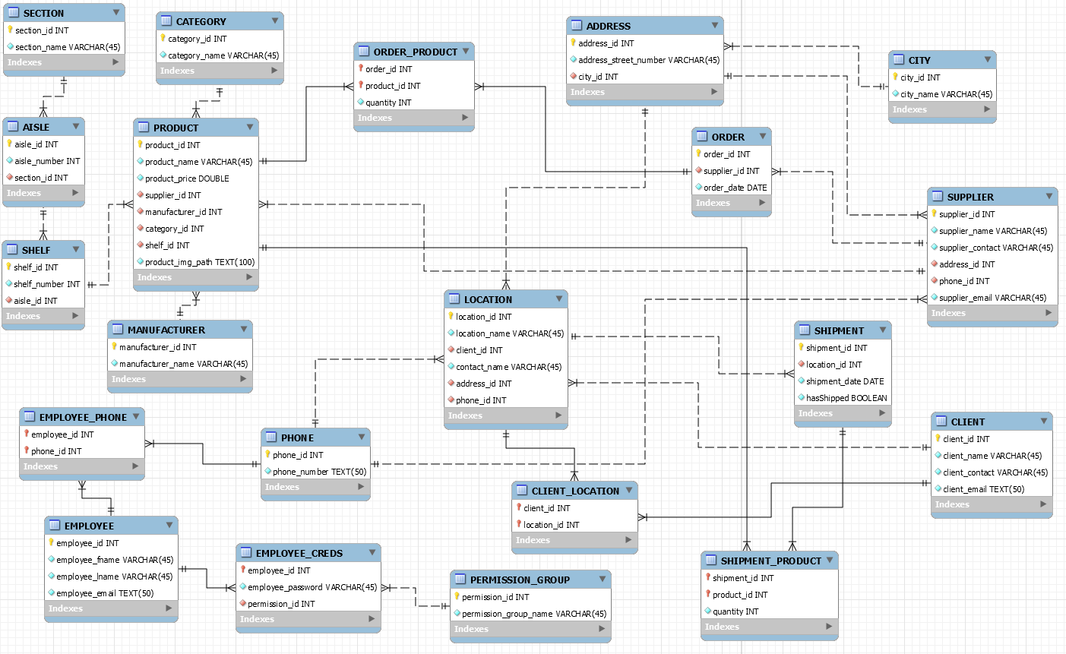
DATABASE ERD
Notes:
DATABASE ERD

